Slide 1
Class & ID Selectors
Tamlyn Laurence
Notes:
Aloha, My name is Tamlyn and I am going to talk with you about class versus ID selectors.

Slide 2
<h1>
<p>
<ul>
Notes:
As you know, in HTML we use H1 tags for headings, P tags for paragraphs, ULs for un-ordered lists,
and many other tags to build the basic underlying structure of web pages.

Slide 3
HTML has changed.
Notes:
In the past when HTML was young, before CSS was implemented, all the code to visually enhance the webpage or text was written right inside the HTML element. It got very confusing, and expecially tedius to edit. HTML needed to change and it did.

Slide 4

Tacos
Notes:
One change was to move all the styling information to the top of the page or to a new page.
Notice the old and new methods for centering a purple recipe title for tacos. The old way added all the sytling instructions right inside the p element. If we wanted it fancier, we could add additional instruction for bolding, or italic, or scrolling, but everything would be added to this same element. Imagine all of these styling instructions needing to be given on every styled element. Even simple webpages got unwieldy to edit.
Now look at the new code. All that is added to the element is a class name, in this case called recipeTitle.

Slide 5
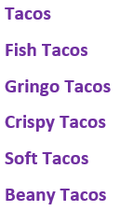
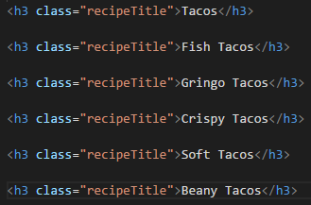
All use the same class
Taco Recipes
Notes:
Let’s look at how easy it has become. If we have a list of different taco recipes that we want to style all the same. We just repeat the same class attribute instead of duplicating all the styling instructions for each item.
Every element on our page with the class name of recipeTitle would be styled the exact same way.

Slide 6
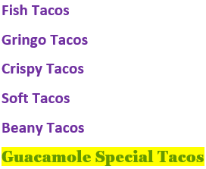
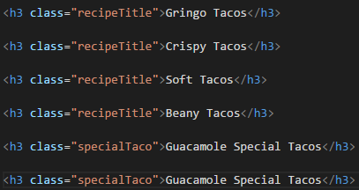
Notice the new class name
Notes:
But what if we wanted one title to stand out – the Guacamole Special Tacos. Again, that’s easy. We would just name it a different class name and assign a different set of styling instructions. In this case – a yellow background, a serifed font, and green text.
Notice that we gave it a different class name of SpecialTaco. All of these styling instructions would be put in a separate CSS styles document.

Slide 7
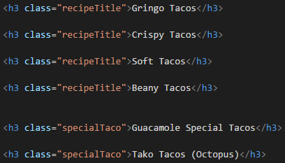
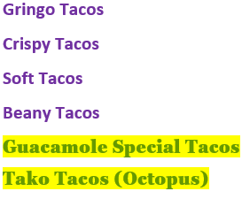
Two have the specialTaco class
Notes:
If we wanted another recipe to have a yellow background, and green serifed text, we would reuse the class specialTaco.
The Japanese word for octopus is taco. In Hawaii we have tako tacos.

Slide 8
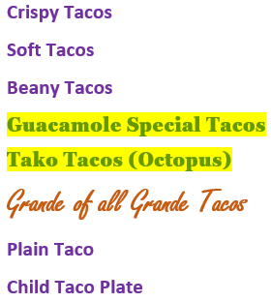
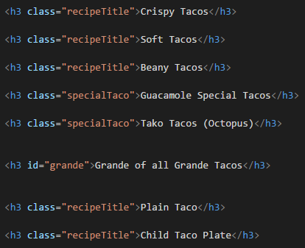
We can use id
(but it is better to use class)
Notes:
But what if we want to target a certain element. If there is one, and only one, we can use an ID instead of a Class. Here we have our most Grande of Grande Tacos which we want to stand out from all the rest. We give it an ID and its own styling. We can use an Id, But class is usually a better choice since ID’s can only be used once on a page.

Slide 9
Class or ID Which do I use?
Notes:
So, which do you use. Class or ID?

Slide 10

What are you trying to catch?
Notes:
It all depends on what you want to catch.
If you will have lots of the same styling on a website or webpage, definitely use class to catch all the elements to which you want to apply that styling.
If you have only one item that needs the extra special styling, you can use id to catch that one item.

Slide 11

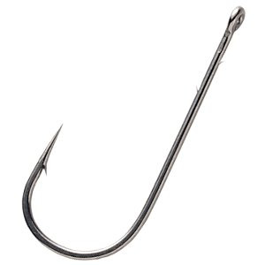
Use the right hook
Do you need to catch one or many?
Notes:
Always use the right hook.
Do you have only one thing to style, or will many elements need the same treatment?

Slide 12
Reusable info
class
Totally unique
id
Notes:
If you have reusable information use the class attribute
If you have totally unique information that will only be used once on a page, use the id attribute

Slide 13
Learn the symbol
#
class
id
Notes:
The class selector can catch many.
The Id selector can catch one and only one item on a page. Since the CSS stylse sheet use symbols to represent words, learn that the word class is represented by a dot - a red dot in this picture. And memorize that the word id is represented by a hashtag, otherwise known as a octothorpe. You will use these symbols often.
The symbol for class in a CSS document is a dot.
The symbol for id is a hashtag. Its real name is octothorpe.

Slide 14
#
class
id
Notes:
We have seen with the taco example how we can use a single class to style multiple items. We also indicated that we could use the id to style single items on a page.

Slide 15
Remember back to JavaScript - - -
we used id’s to target certain places
in the document
Notes:
...but there are better uses for the id. For instance ...

Slide 16
Remember back to JavaScript - - -
we used id’s to target certain places
in the document
document.getElementById("outputDiv").innerHTML = result;
<body>
<h1>What is the Wind Chill Factor?</h1>
<div id="outputDiv"></div>
Notes:
Remember in JavaScript how we were able to target and catch an exact place or element, either to gather user input, or to output an answer.
Do you recall the getElementById that we used to hook some action to a tag.
Classes can’t do that, but ID’s can.

Slide 17
<p id="top">
<a href="#top">Take me to the top of this page.</a>
Result
Take me to the top of the page.
Notes:
Another way id’s are useful are when you want to create links to sections on the same page in HTML.
For instance, you may want to move back to the top of the page.
You would do this by using the #id selector and then creating a link to the selector
Again, classes can’t do that but id’s can.

Slide 18
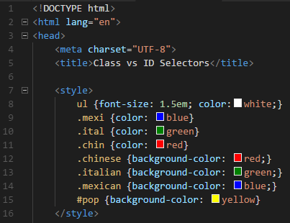
Notes:
So let’s move back to styling pages with classes. One way is to put the style tag in the head of the document. Here we have the style tag wrapping around several selectors, the ul, the class indicated by a dot, and an id indicated by a hashtag. SO, the UL will have white lettering at 1.5em. The classes called mexi will have blue lettering. Ital will have green, and chin will have red
The class Chinese will have a background of red. Italian will have a green background, and Mexican a blue. Finally, the id, which is reserved for only one item on the page, will have a background of yellow.

Slide 19
3 Kinds of Selectors
ELEMENT selector
Tag name
example: ul, h3, p
CLASS selector
dot .
example .mexi, .ital
ID selector
hashtag #
example: #pop
Notes:
This example shows three kinds of Selectors – Element, Class, and ID.
The element selector uses the tag name directly with no symbol, for example the ul, h3, or p tag
In the style tag or on a CSS page, the class selector will start with a dot. In this example .mexi could be read class mexi or mexi class. There are several different classes in this style tag. Class mexi, class ital, class chin, class Chinese, class Italian, and class Mexican.
The id selector uses the hashtag or octothorpe. In this example we would read id pop. Now let’s look the html body.

Slide 20
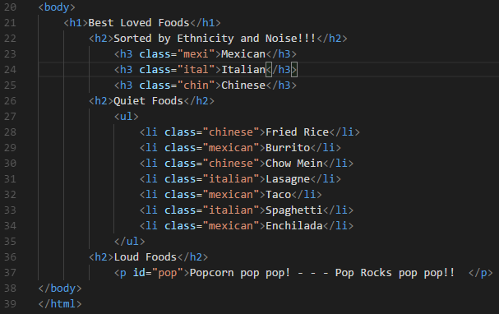
Notes:
Here we have several headings for Best Loved Foods, Sorted by Ethnicity and Noise, Quiet foods, and Loud foods. We move from h1, to h2 to h3. Then we have an unordered list of different entrees to which we want to give a color specified by class.
Finally we have a unique line of loud foods that receives an id.

Slide 21
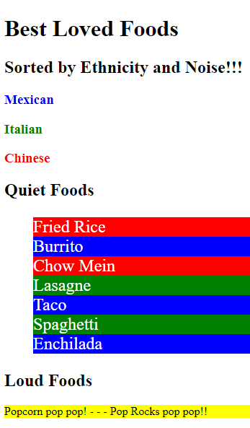
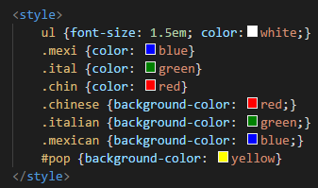
Notes:
So the words Mexican, Italian, and Chinese each receive styling from the classes, mex,ital, and chin.
The Quiet Foods received their background color from classes Chinese, Italian, and Mexican, and their letter color of white from class ul. The Loud food line in yellow received its instructions from the id pop. Each ethnicities foods received appropriate styling from the class. For instance the class Mexican styled 3 blue lines in this example

Slide 22
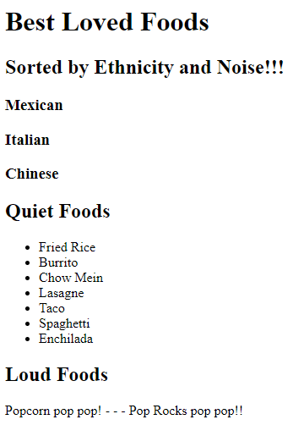
The hooks are in
Notes:
Adding an id or various classes to an element does not do anything in the browser window. The user will be totally unaware. The only time something happens is when that selector is hooked to a script or style document outlining the CSS or JavaScript that should be used

Slide 23
ID’s are more specific
than classes.
Notes:
It’s important to note that in terms of specificity and id’s are more specific than a class.

Slide 24
Recap
#
class
id
Notes:
So to recap what we talked about, it is all about using the right hook. classes are like multihooks - they are not unique. You can apply the same class to as many elements as you want. You can also have multiple classes on the same element. ID’s are like single hooks. They are unique. Only one element per page can have the same ID. HTML has changed and will continue to change. . Once the hooks are put into your document, you can change your styling in a jiffy instead of a stressful weekend. Use a dot to mean class and a hashtag to mean ID. Thanks for watching. Aloha everyone.

Slide 25
Picture credits
https://www.aliexpress.com/item/16pcs-fishing-hook-Explosive-hook-Plate-Multi-hook-With-9-Small-Hooks-Fishing-Fishing-Rigs-Tools/1714760995.html
By Lsuff - Own work, CC BY-SA 3.0, https://commons.wikimedia.org/w/index.php?curid=109600
https://www.basspro.com/shop/en/fishing-hooks

Slide 26
References
https://css-tricks.com/the-difference-between-id-and-class/
http://www.htmldog.com/guides/css/intermediate/classid/
https://www.w3schools.com/css/css_syntax.asp
https://teamtreehouse.com/community/when-do-you-use-class-vs-id-elements

